Slide 1


Slide 2
Sand Hill Road Bicycle Access Improvements
Joe LoCoco
February 16, 2016

Slide 3
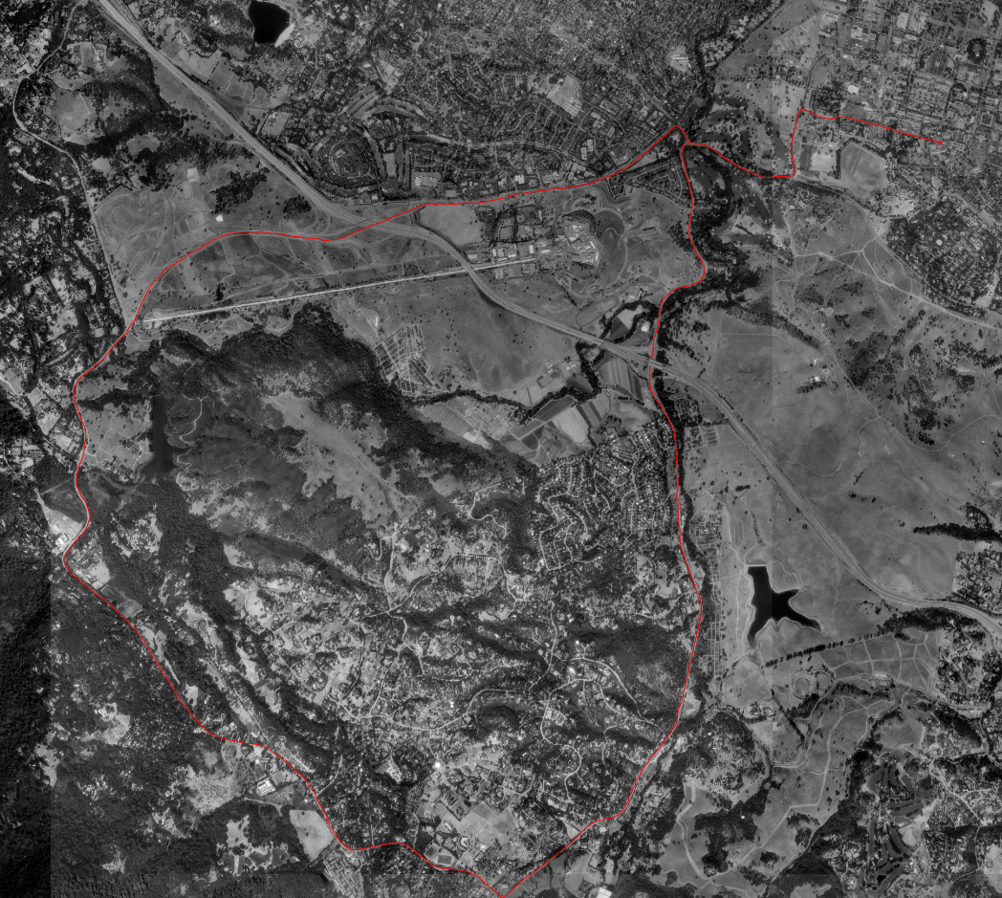

How Many Bicyclists are Affected?
The Loop - Bike Route
“The Loop” is a popular route for cyclists
This route can be found on:
  mapmyrides.com
  ridewithgps.com
  Stanford.edu
  bayarearides.com
  and many other popular bicycling sites
Area Targeted for Improvements
https://web.stanford.edu/group/cycling/routes/Aerials/the_loop_photo.jpg
From http://bayarearides.com/rides/theloop/ -
”It's also worth noting that the ride passes through two freeway interchanges (both of them with I-280) where you have to ride in a bike lane that's in between traffic lanes as other vehicles try to merge in and out around you. If you're the kind of rider who feels uncomfortable riding in traffic, this might be an important point to consider. ”
Notes:
We do not have any weekend bike volumes that I could locate so I added this to show that it is a recognized route that likely receives significant traffic.

Slide 4

How Did We Get Here?
San Mateo County Department of Public Works has been working with various community bicycling organizations to increase vehicle and bike safety along the Sand Hill at the 280 crossing.
Supervisor Don Horsley has committed $120,000 towards funding these improvements.

Slide 5
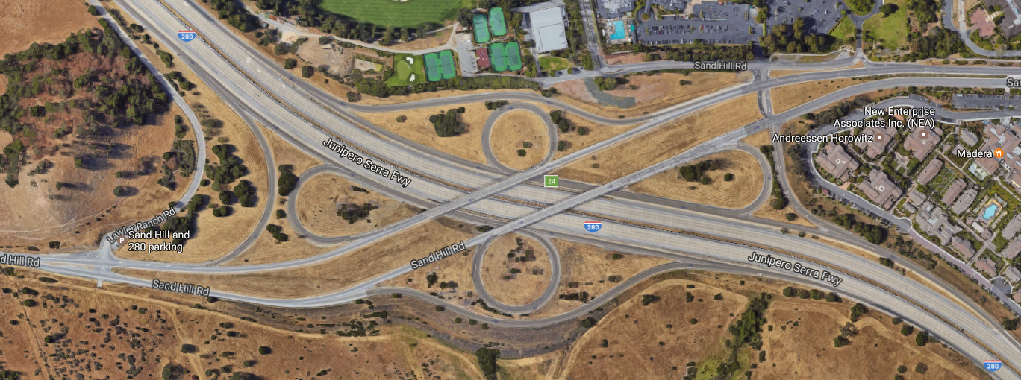
Areas of Concern
A
B
C
A – Right to center bike lane crossover at approach to 280N on-ramp
B – Narrow center bike lane on overpass
C – 280S off-ramp crosses unmarked bike lane

Slide 6
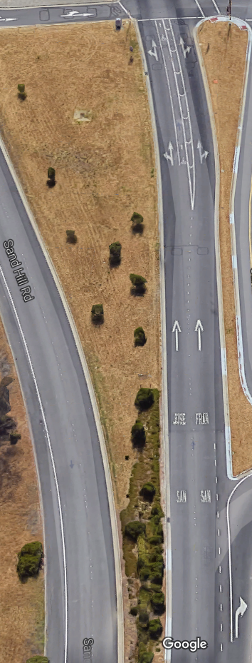
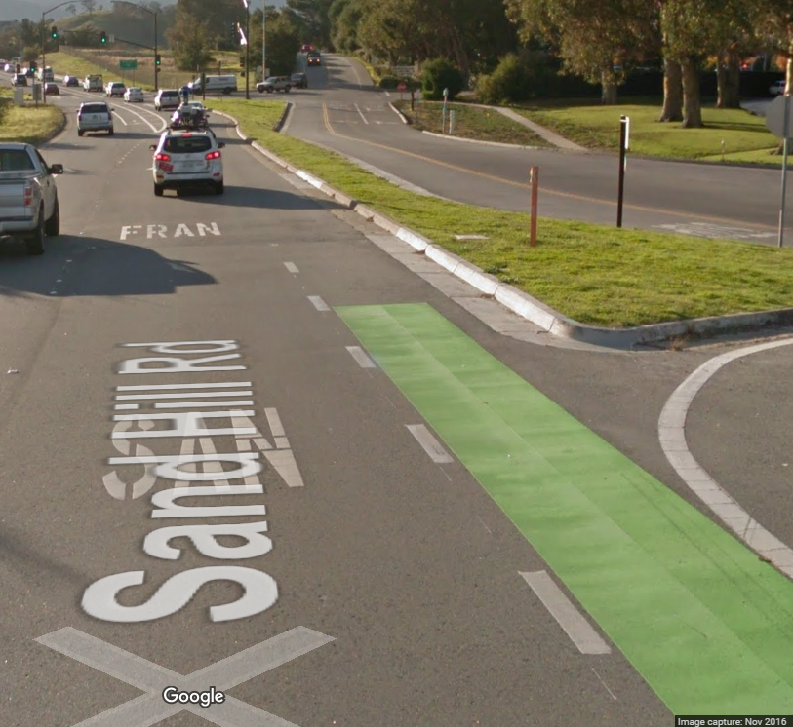
A – Right to center bike lane crossover at approach to 280N on-ramp

Slide 7
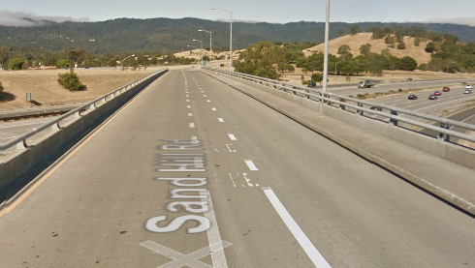
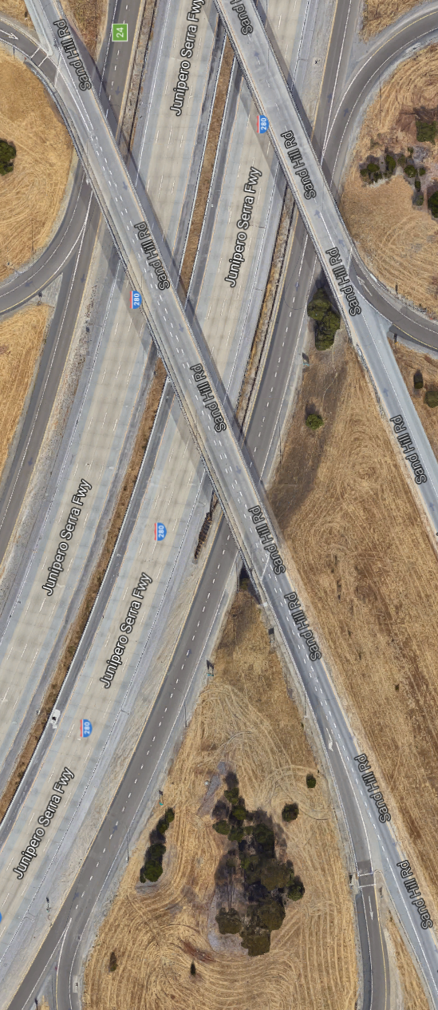
B – Narrow center bike lane on overpass

Slide 8
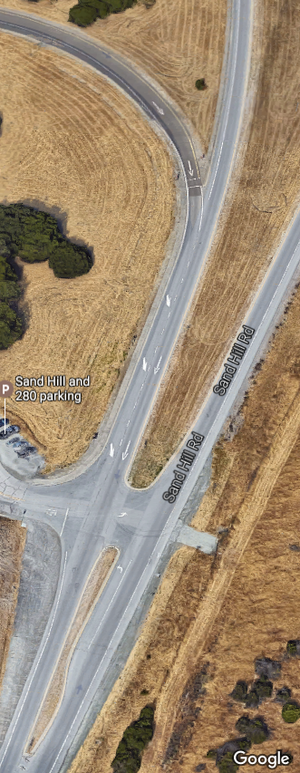
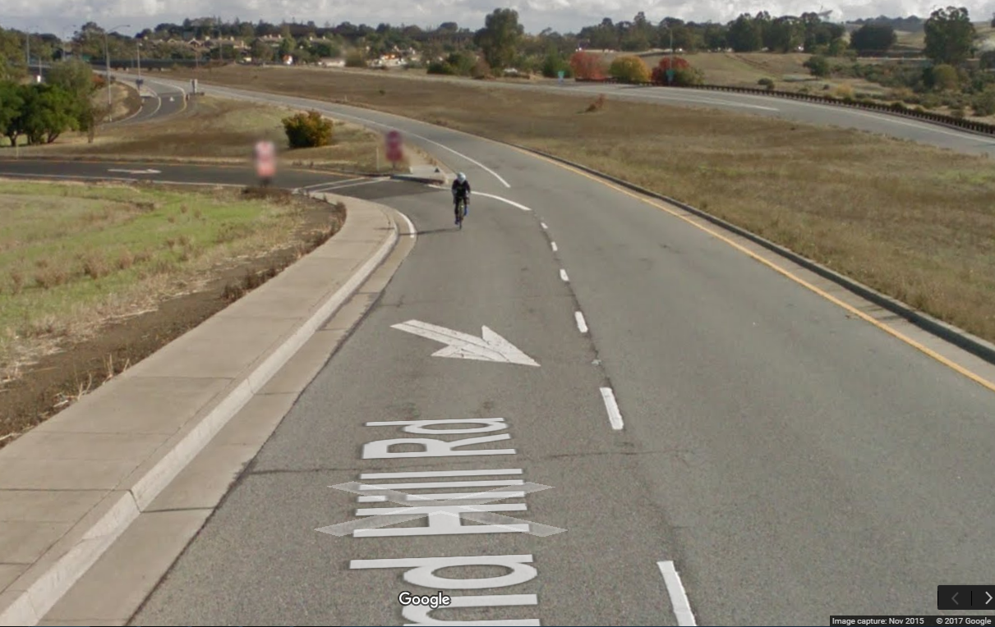
Area C – 280S off-ramp crosses unmarked bike lane

Slide 9
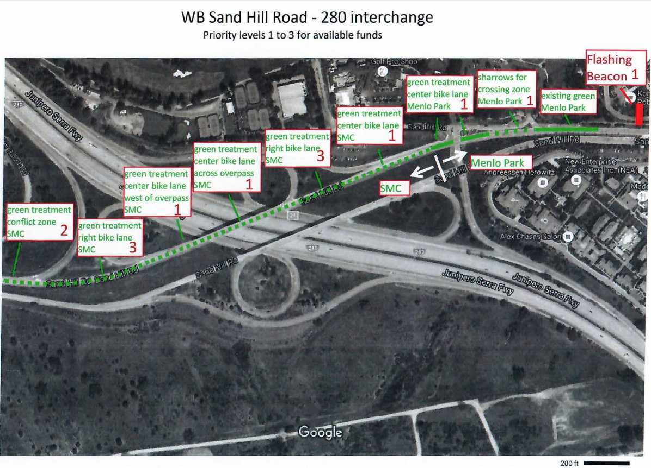
Improvements Contemplated

Slide 10
Where Do We Go From Here?
Department of Public Works:
  is seeking BPAC support or alternative recommendations
  will work with Caltrans regarding the implementation of green bike lanes across the 280 overpass

Slide 11
Questions or Comments?

