Slide 1

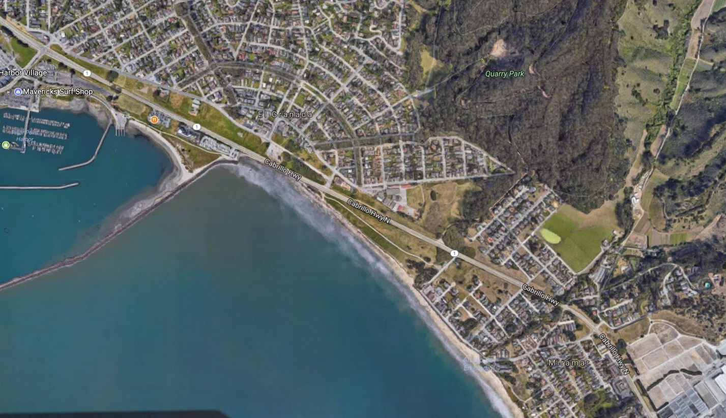
Midcoast Multimodal/Parallel Trail
County of San Mateo
June 20, 2019

Slide 2
Purpose of Presentation
Project Description
Regional Trail Connections
Project Need and Community Support
Request Letter of Support from BPAC for the C/CAG Article 3 TDA grant application

Slide 3
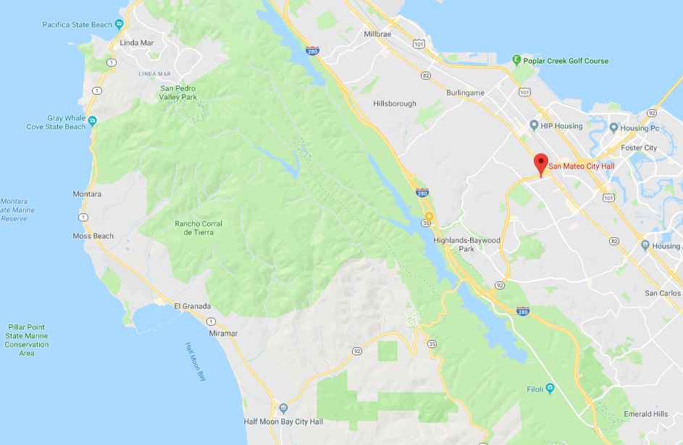

Slide 4
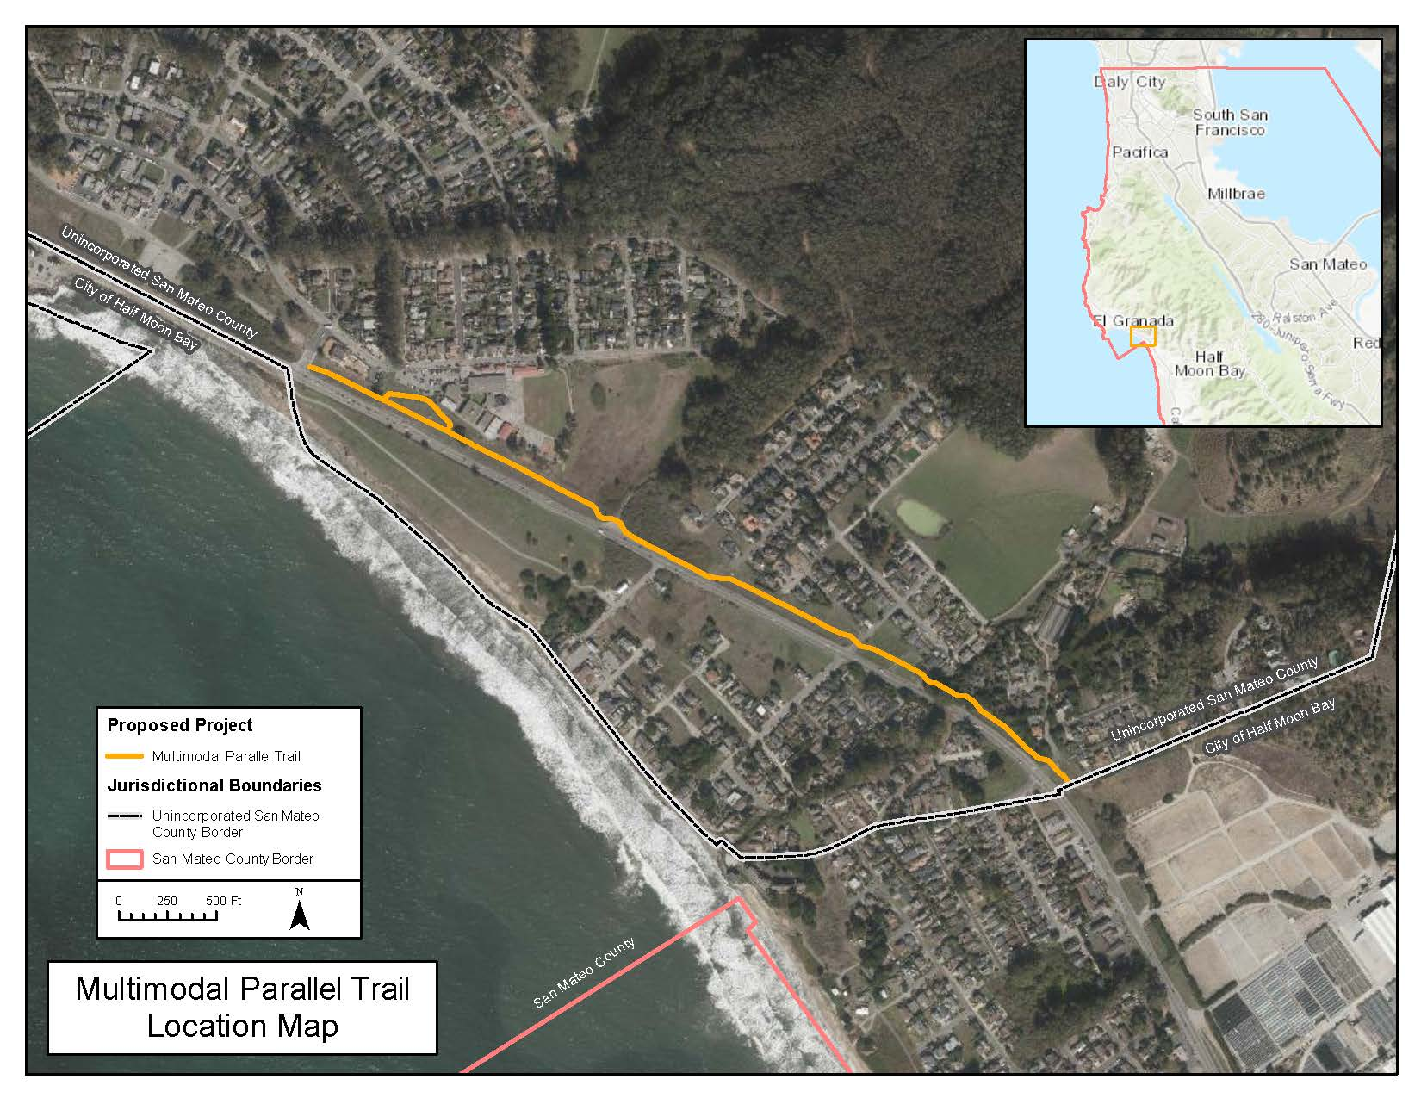

Slide 5
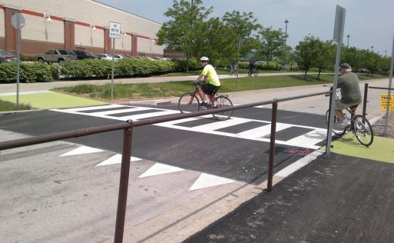
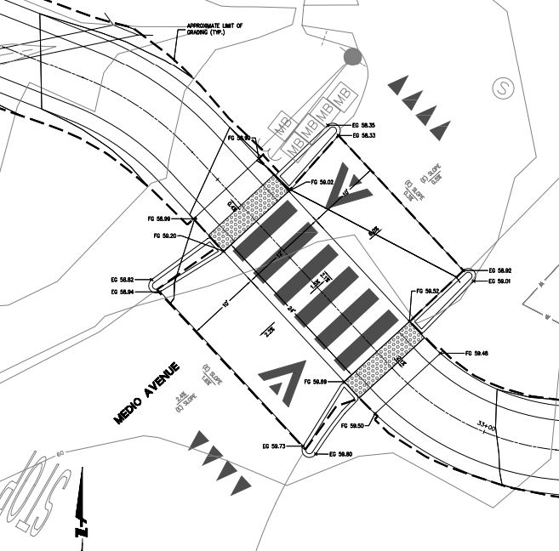
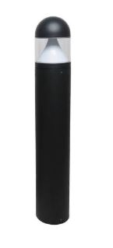
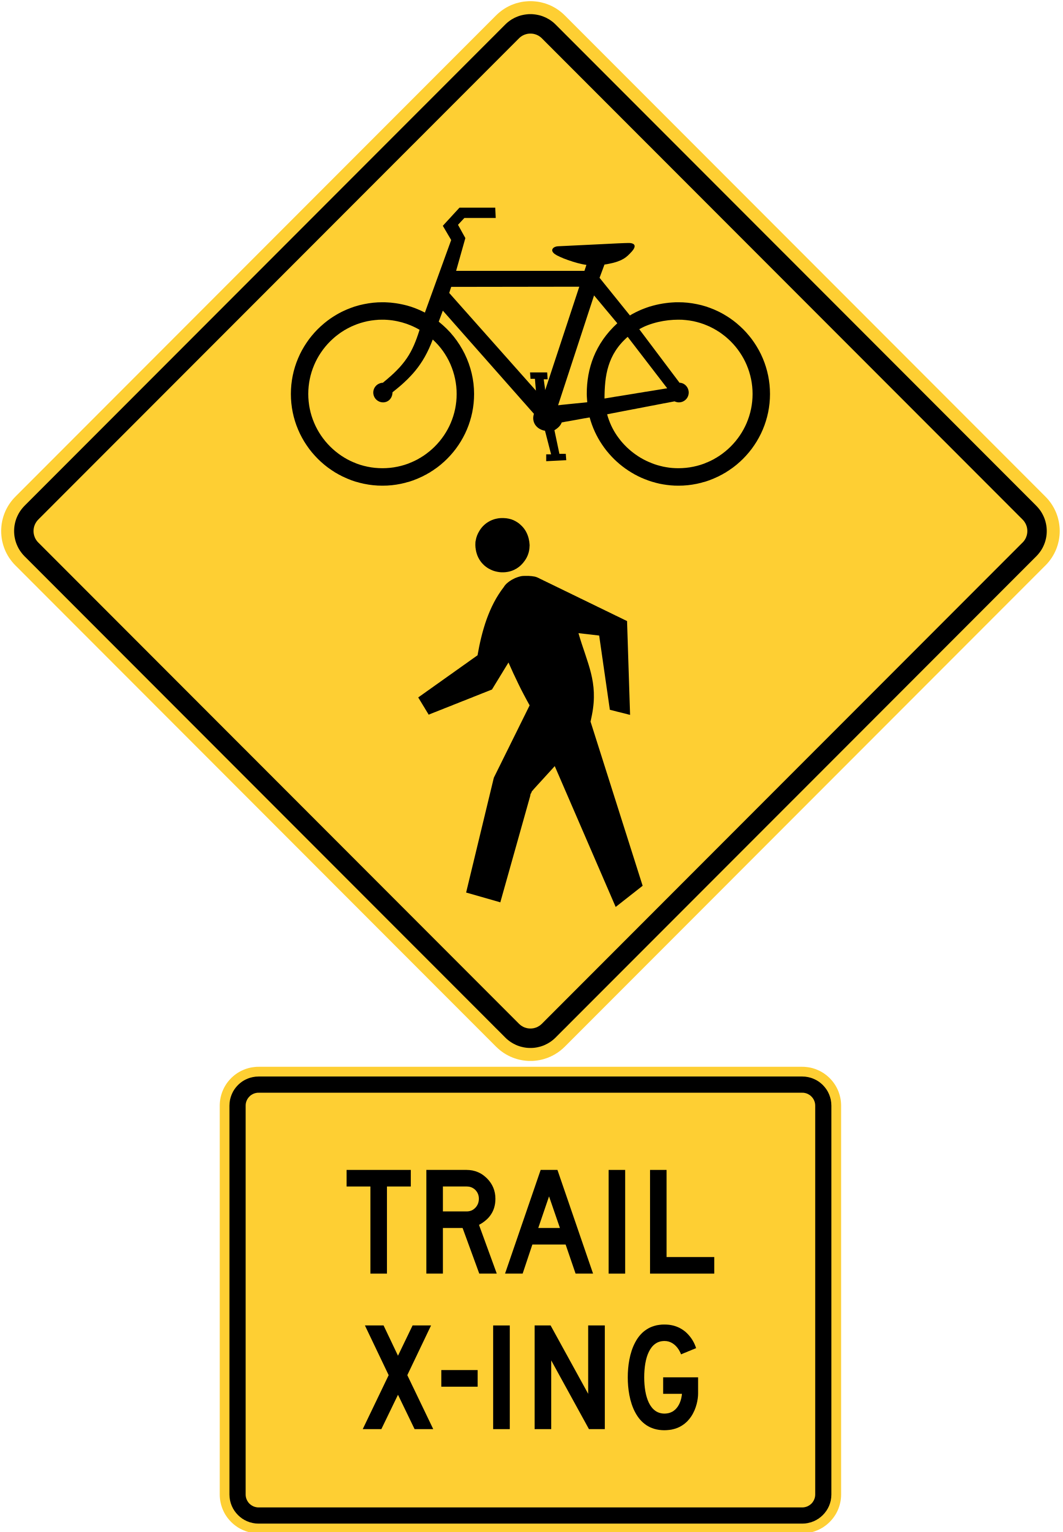
Project Design Elements

Slide 6

Regional Trail Connections

Slide 7
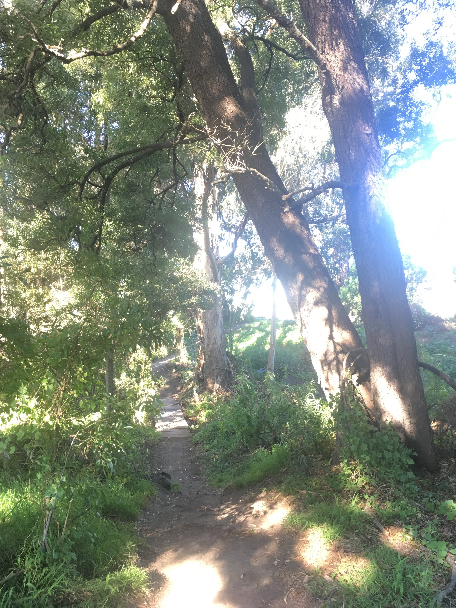
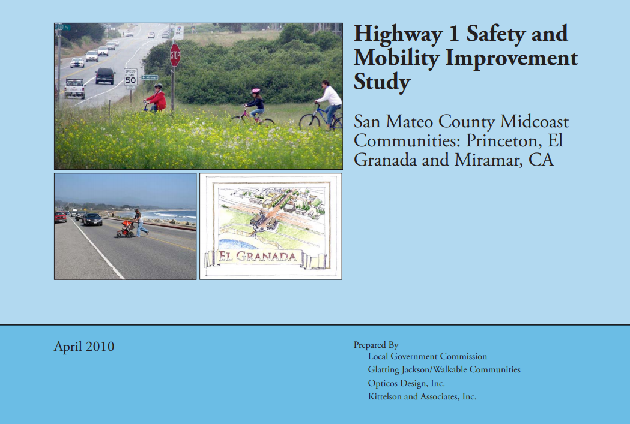
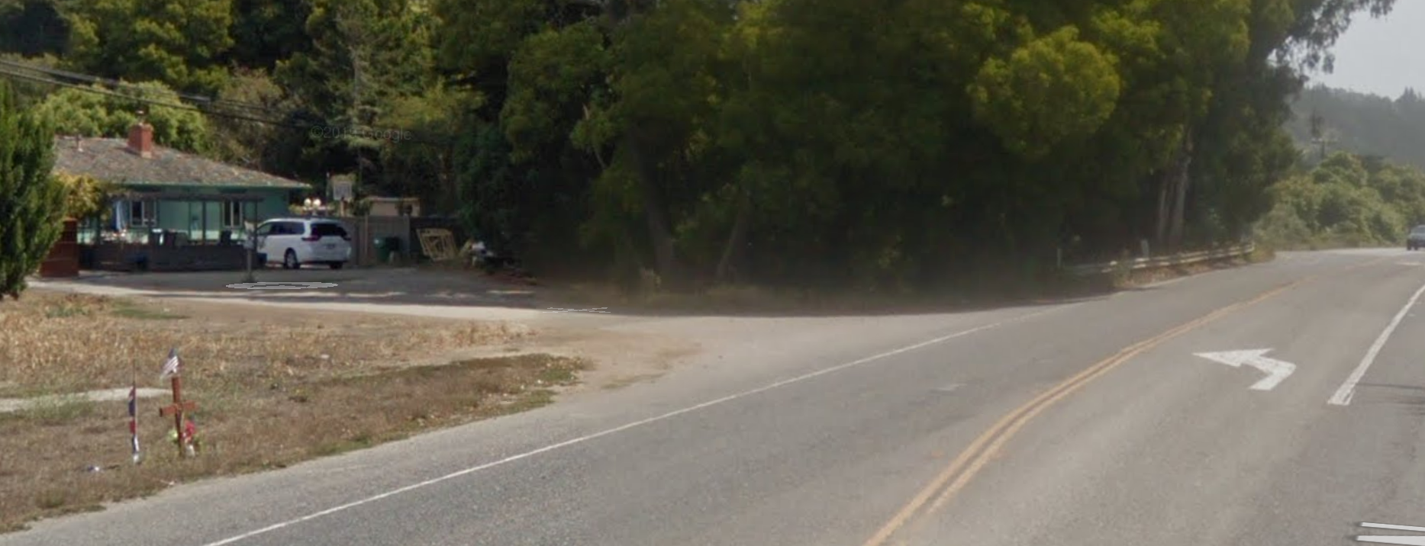
Project Need
Memorial for cyclist killed on Hwy 1

Slide 8


Community Support Received to Date

Slide 9



Anticipated Community Support
San Mateo County Bicycle & Pedestrian Committee
Parent Teacher Organizations
(PTO)

Slide 10

Questions?
Elizabeth Dallman
Office of Supervisor Don Horsley
edallman@smcgov.org

