Slide 1
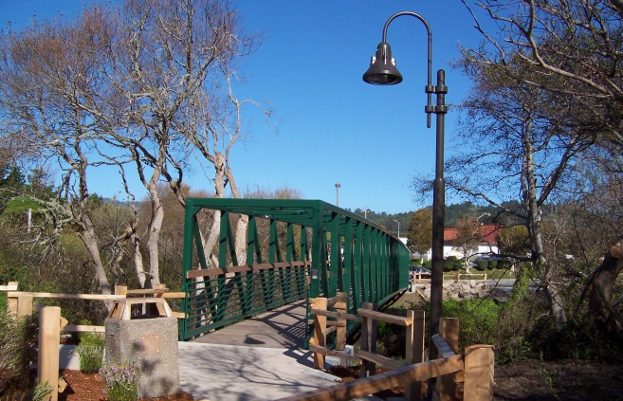
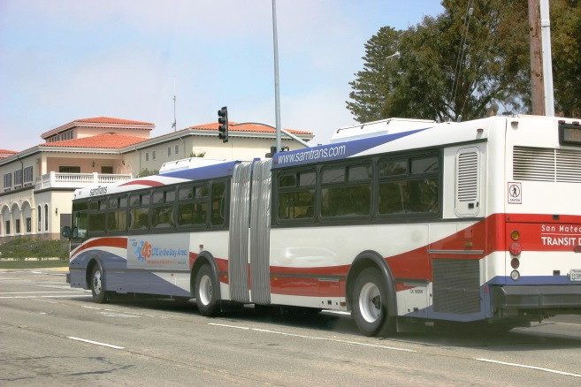
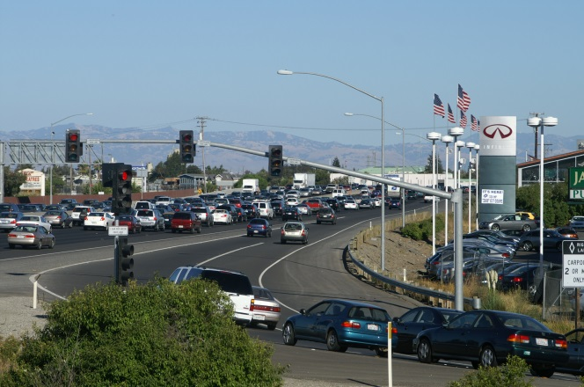
San Mateo Countywide Transportation Plan update
Presentation to
SMCBPAC
October 11, 2016
Notes:
CTP 2010 adopted in 2001
Started work on update in 2009
2012 – 2013 Continued work (contracted with DKS)
Current effort began in February 2016
Update and Revise the 2013 Draft CTP

Slide 2
Countywide Transportation Plan (CTP)
Comprehensive, Long-Range Transportation Strategy Document
Provides a Coordinated Planning Framework
Articulates Clear Transportation Planning Objectives, Goals and Policies
Builds upon and reflects Plans and Strategies of the TA, SamTrans, Caltrain, and the Local Governmental Entities within San Mateo County
Update to meet all MTC CTP Guidelines
2
Notes:
In addition, incorporate MTC Guidelines for CTP Plans (issued in 2014):
Use of Demographic Projections Consistent with the Plan Bay Area
Recognition of the Goals and Targets of Plan Bay Area
Contribution to the Next Update of Plan Bay Area
Adequate Opportunities for Public Input
Evaluation of Social and Economic Equity
Includes being consistent with the Plan Bay Area (OBAG)

Slide 3
Approach – Key Strategies
Enhancing Transit Capacity, Service Frequency and Connectivity
Getting the Most out of Existing Roadway Infrastructure – Managed Lanes, ITS and TSM
Managing Demand through Employer-Based Trip Reduction Programs, Parking Policy and Pricing
Improving Safety for Pedestrians and Bicyclists
3
Notes:
Some of the key strategies includes:
Enhancing transit
Optimizing existing roadway infrastructure
Improve Transportation Demand Management
Addressing Bike and Pedestrian concerns

Slide 4
Major Initiatives
Land Use and Transportation Integration
Implementing Managed Lanes on US 101
Integration with BART, Caltrain and High Speed Rail
Expanding SamTrans Express Bus and Commuter Services
Bus Rapid Transit or Transit Signal Priority
Arterial Management
Complete Streets
Highway Performance Assessment
4
Notes:
The CTP will present the performance (or condition) of the Highway System
Four Performance Measures are proposed:
Existing Congestion (Vehicle Hours of Delay)
Project Growth in Congestion
Travel Time Reliability
Safety

Slide 5
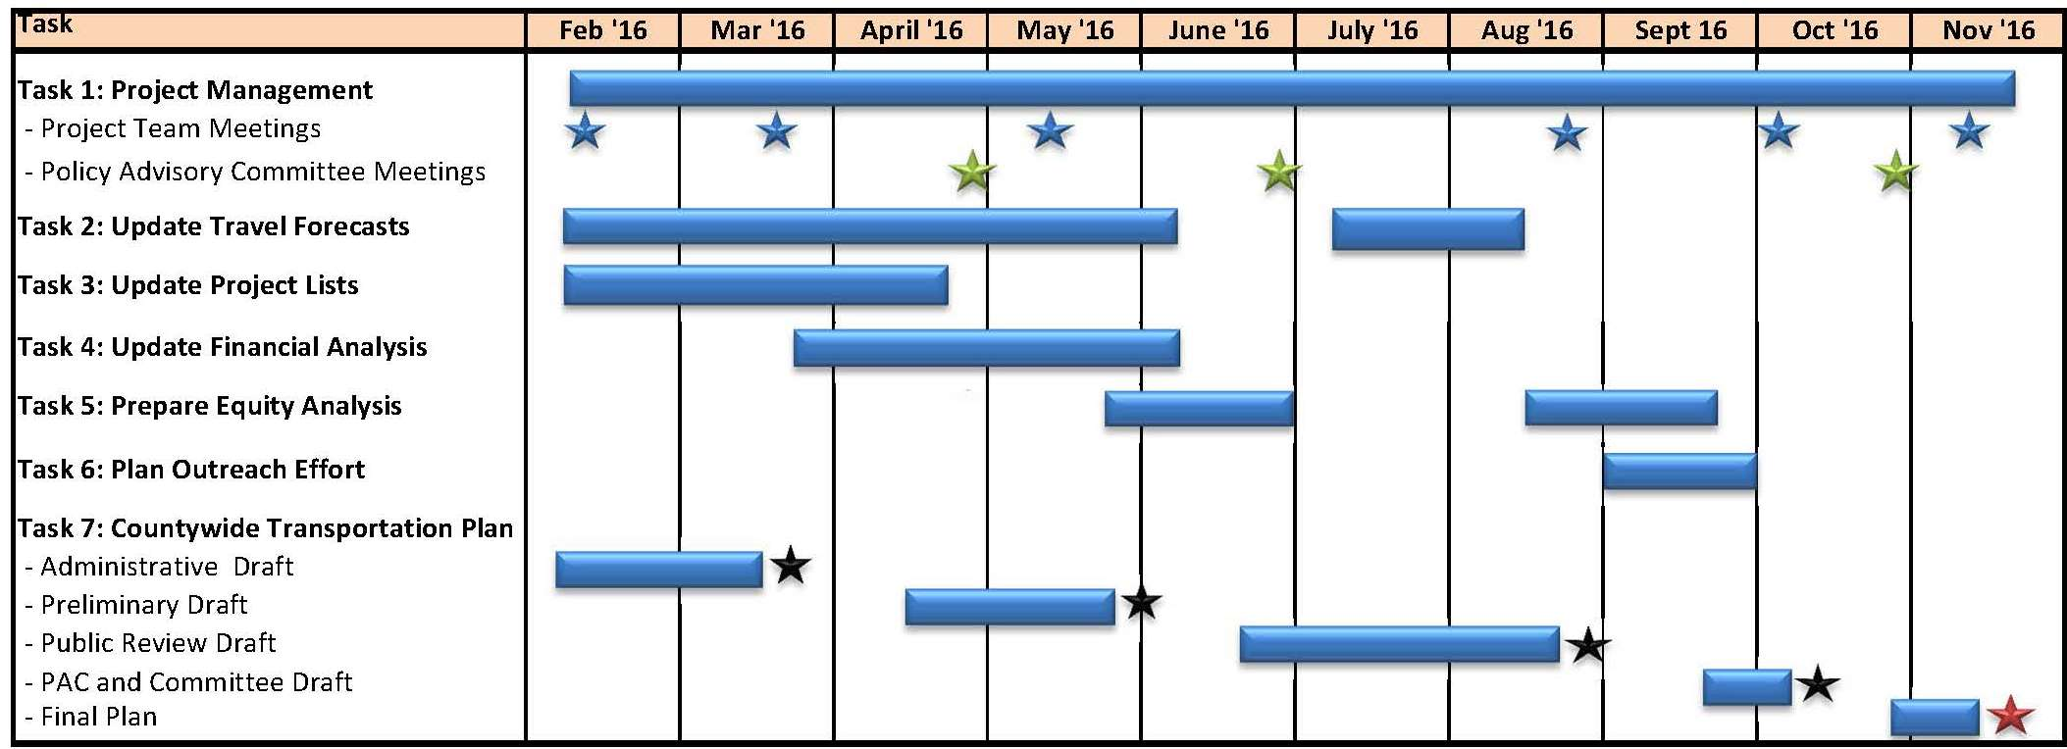
Project Schedule
5
Notes:
Updates the CTP adopted in 2001
MTC Guidelines for CTP (2014)
Update Travel Forecast Information
Update Project Lists
Update Financial Analysis
Prepare Equity Analysis
Plan Outreach Effort
Next Steps
Prepare Public Review Draft CTP
Presentation to the C/CAG Board in September
Public Outreach Meetings in Sept/October
Final

Slide 6
Public Review Draft
Posted to the C/CAG Web site September 2 - http://ccag.ca.gov
Public Outreach Meetings (all 6:30-8:30 PM)
  September 27 - Pacifica
  September 28 – South San Francisco
  September 29 – Menlo Park
Stakeholder and Committee Meetings - TBD

Slide 7
Reviews of the CTP Drafts
Project Team – March 26 - Admin Draft
CMEQ Committee – April 25 CTP Outline Policies, Goals and Objectives
Project Team – June 1- Preliminary Draft
CMEQ Committee – June 27 – Preliminary Draft
Project Team - August 30 – Public Review Draft

Slide 8
Summary of Comments - Roadways
Develop a methodology for defining priorities for roadway projects
Add consideration of “induced” demand from roadway capacity expansion
Review description of US 101 Corridor: policies for managed lanes and multimodal travel

Slide 9
Summary of Comments - Transit
Address potential duplication of transit service by shuttles and/or private employer transportation
Address role of on-demand and shared mobility services

Slide 10
Summary of Comments – TDM and Parking
Transportation Demand Management
  Policies to encourage jurisdictions to set TDM goals and report performance
Parking
  Move discussion of parking policies from Land Use/Transportation
  Policies for pricing and parking requirements for development

Slide 11
Summary of Comments - Finance
Policies to allocate funding based on mode share targets
Policies to fund rail grade separation projects
Allocation of STIP funds for roadway and transit projects

Slide 12
Next Steps
Initiate Public Review Draft CTP
  Presentation to C/CAG Board in September 2016
  Open public participation process – post Draft CTP
  Multiple public and stakeholder meetings Sept/Oct
  Receive comments and feedback
Final CTP 2040
  Revise Draft CTP for Project Team and CMEQ Review
  Prepare Final CTP for C/CAG Board Review and Adoption
12
Notes:
Does the Plan provide adequate and appropriate direction and guidance?
Does the Plan address the appropriate issues and challenges with the appropriate initiatives?

